Slide 1

PROJECT: ROAD
ACCIDENT ANALYSIS
The goal: To inform and empower
you to make safer choices on the road.
Key statistics: Over 1.3 million
people die each year from road
crashes globally (WHO).

Slide 2
The Human Cost: Impact of Road Accidents By Road Surface and Weather
Rain: Wet roads reduce tire traction, increasing stopping distances and the risk of hydroplaning. Rain can also obscure visibility, making it harder for drivers to see hazards or other vehicles.
Fog/Snow: Dense fog drastically
reduces visibility, making snow and
snow significantly decrease traction, especially on bridges and overpasses, making it difficult for vehicles to maintain control.
Wind: Strong gusts of wind can cause drivers to lose control, particularly for high-profile vehicles like trucks, buses, and motorcycles.
Extreme Heat: Heat can cause tire blowouts, especially if the tires are underinflated, and it can cause fatigue among drivers

Slide 3

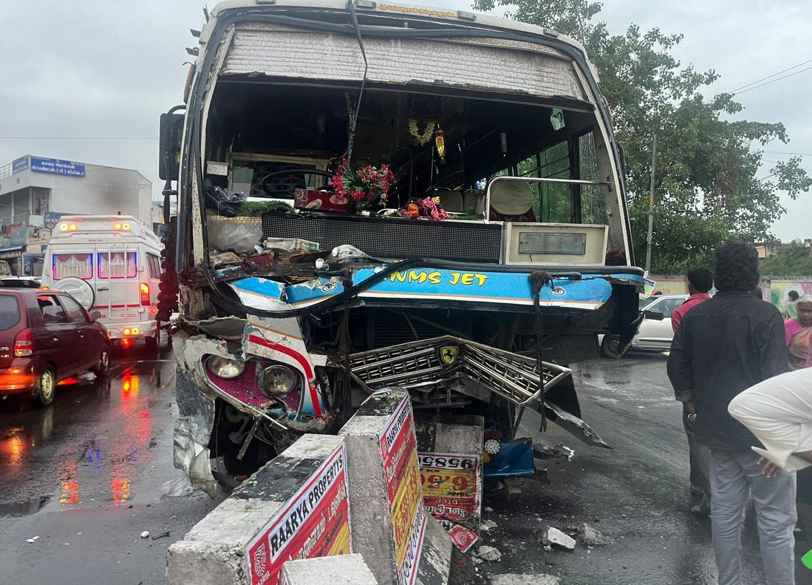
Categories of casualties and accidents : Responsible for Road Accidents
Current Year Casualties
Current Year Accidents
Fatal Casualties
Serious Casualties
Selight Casualties

Slide 4

Lets see impact of casualties
CY Casualties : Road accidents are a major public health concern in India, with over 450,000 reported accidents responsible for over 150,000 deaths in 2022.
CY Accidents : Total number of fatal road accidents
had increased from 1,42,163 in
2021 to 1,55,781 in 2022,
registering an increase of
9.6 percent .

Slide 5
Types of vehicle : Responsible for Road
Accidents
Agricultural
Bike
Bus
Other
Van

Slide 6

Other calculations we can analiysed
Month tends CY and PY Casualties by line graph
Casualties by road type from
Bar graph
CY Casualties by urban/rural and
Light condition by light condition will be represented by Donut chart
Casualties by Location through Map

